Slide 1
A beginners guide to ACT process measures
Ron Rogge
Jenn Daks, Brooke Dubler, Katie Saint

Slide 2
Process Scales
AAQ-II
OESQ
CompACT
MPFI
Inflexibility
Flexibility

Slide 3
Process Scales
AAQ-II ➔ Inflexibility
OESQ ➔ Inflexibility
CompACT
MPFI

Slide 4
Process Scales
AAQ-II ➔ Inflexibility
OESQ ➔ Inflexibility
CompACT ➔ 3 facets
MPFI ➔ 12 facets
➔ FLEX & INFLEX

Slide 5
Evaluating scales
Quantitative data
2,835 respondents
Qualitative data
Case study

Slide 6
Quantitative study
Process measures
Outcomes
Depressive symptoms (PHQ-9)
Life satisfaction (SWLS)
Quality of life (QOL)

Slide 7
Predicting outcomes
First step
AAQ-II
Second step
One newer scale

Slide 8
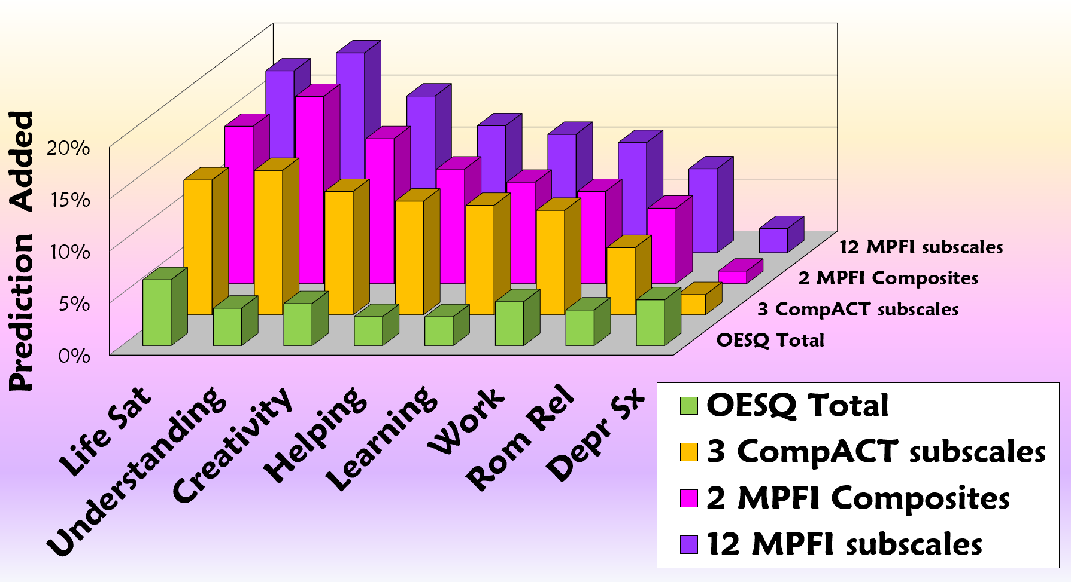

Slide 9
Predicting outcomes
First step
MPFI 12 subscales
Second step
One other scale

Slide 10
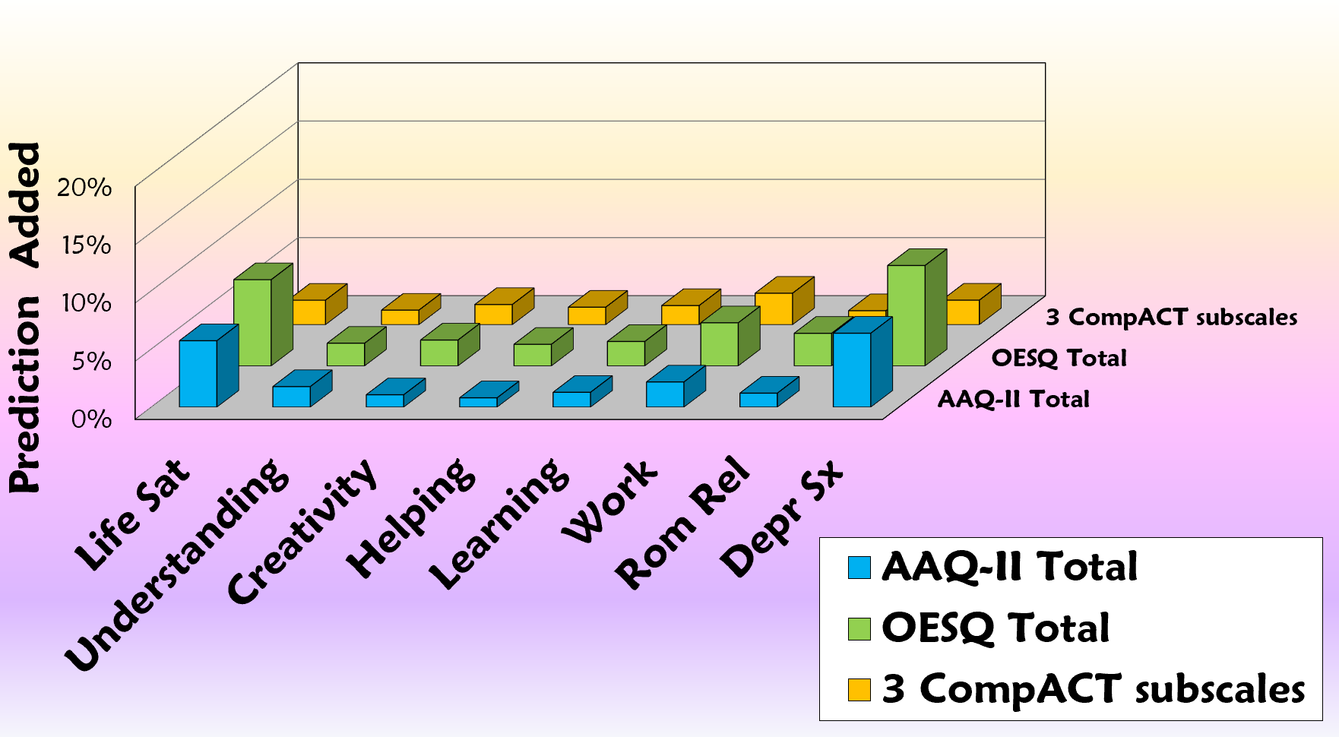

Slide 11
Additional findings
MPFI…
comprehensive
flexibility
unique patterns
60 items?!?

Slide 12
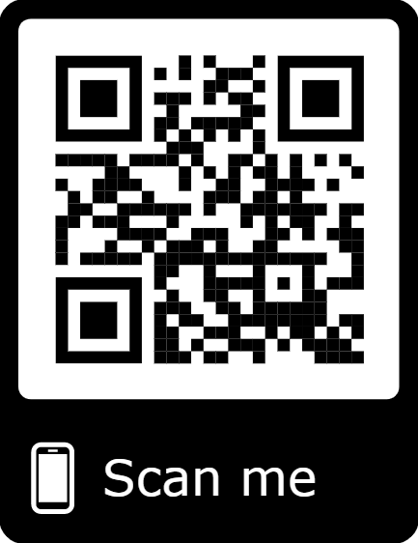
MindFlex Assessments
Online
Free!!!
15-20 min
scored
normed
graphed ➔ profile

Slide 13
MindFlex
Flexibility
AAQ-II, CompACT, OESQ, MPFI
Functioning
Depr & Anx
Wellbeing

Slide 14
Case study
Female
Late 20’s
Trauma
Depression
➔ 4 week, 8hr ACT group

Slide 15
AAQ-II Profile
Scored
Normed
T-scores
M = 50
SD = 10

Slide 16
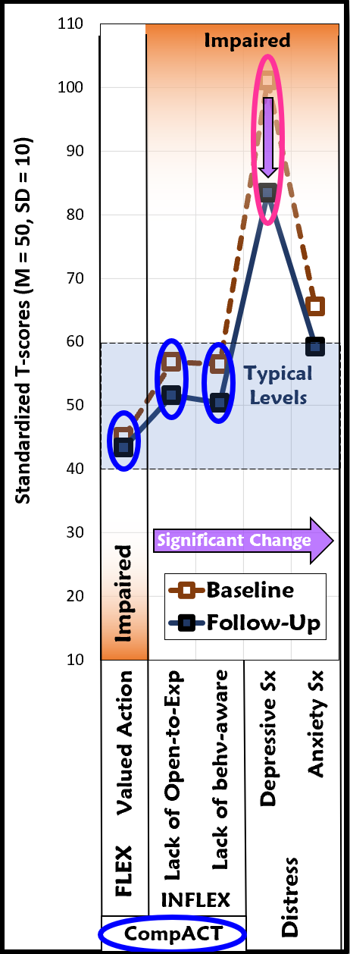
CompACT
No sig change
Valued action
Lack of Open-Exp
Lack of Behv-aware

Slide 17
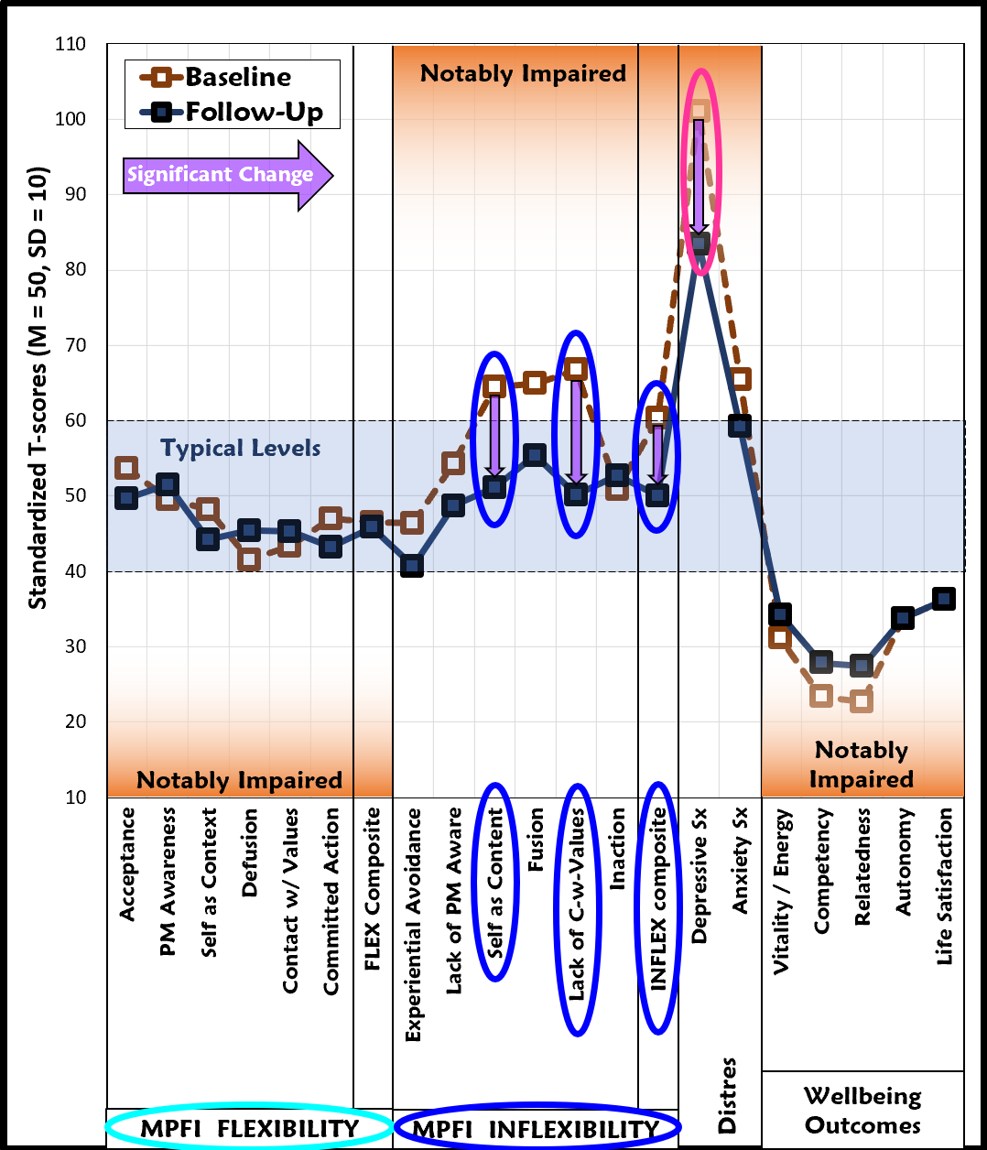
MindFlex
No change
Flex
Wellbeing
Sig drops
INFLEX
Self-as-content
Lack C-w-values

Slide 18
MindFlex
No change
Flex
Wellbeing
Sig drops
INFLEX
Self-as-content
Lack C-w-values

Slide 19
Summary
MPFI
Comprehensive
More info
MindFlex
More clinical info

Slide 20
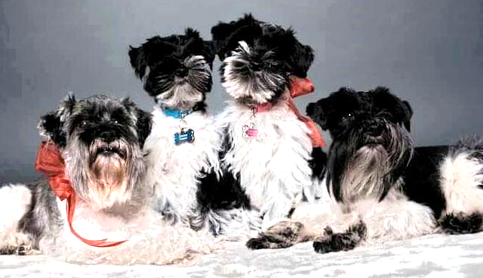
Thank You!

